Slide 1
EDUC 200C
Friday, October 26, 2012

Slide 2
Goals for today
Homework
Midterm exam
Null Hypothesis
Sampling distributions
Hypothesis testing
Mid-quarter evaluations

Slide 3
The null hypothesis
Example: A study compares the results of a new reading program for middle school students. In this study, 36 students received the experimental reading program.
Each student’s reading score was measured before and after the program.
What is the variable of interest?
--The variable of interest is the score change for each student.
  --Score change is positive if a student’s score improved and negative if the score got worse and zero if the student’s score didn’t change.
What is our null hypothesis?
Notes:
Write out null hypothesis on board.

Slide 4
Hypothesis testing vocabulary
Null Hypothesis: A hypothesis to be tested.
Use the symbol H₀ (e.g. H₀ : X=0)
Alternative Hypothesis: A hypothesis that represents the opposite of the null hypothesis.
One or the other must be true, there can be no third option
Use the symbol H_{A} or H₁ (e.g. H_{A} : X≠0)
Hypothesis Test: The test of whether the null hypothesis (H₀) should be rejected in favor of the alternative hypothesis.

Slide 5
The importance of sample size

Slide 6
Sampling Distributions
Population distribution
  Based on all members on a population
  μ and σ
  Rarely do we know true values, hope to estimate them
Sample distribution
  Based on a single sample of the population
  Calculate these to try to describe the population
Sampling distribution
  From multiple samples, each with own mean and sd
  Distribution captures uncertainty about how well the sample statistics represent the population parameters

Slide 7
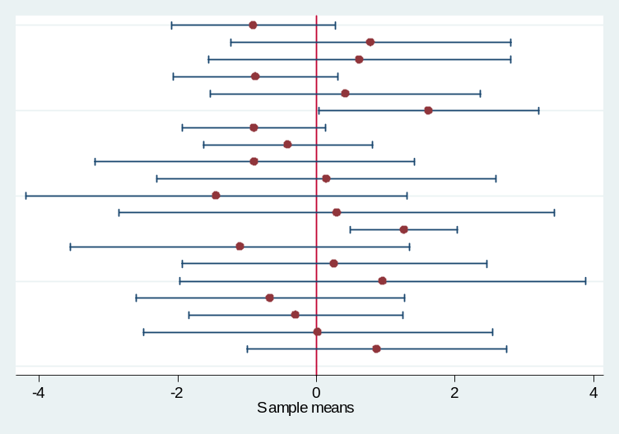
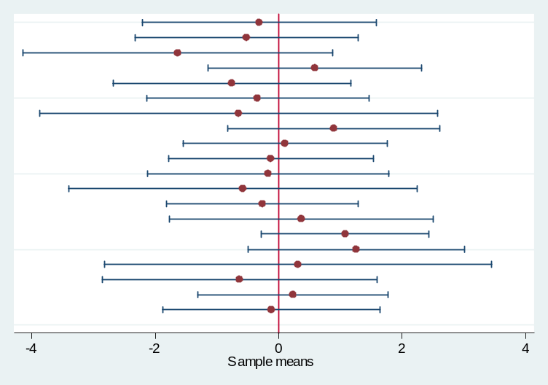
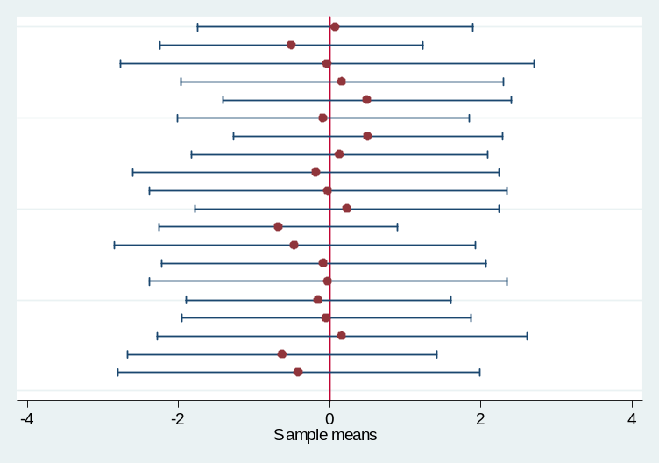
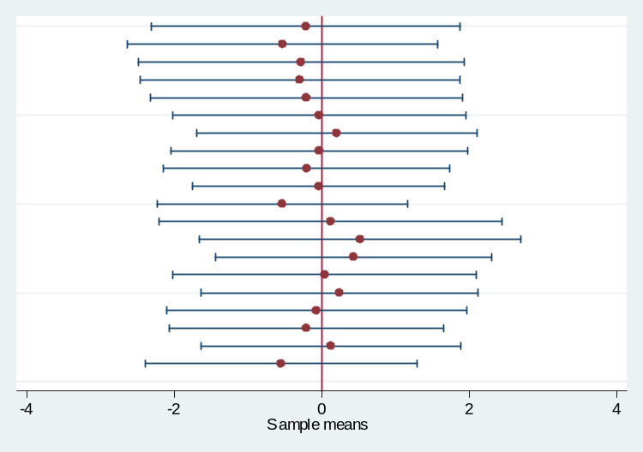
20 samples randomly drawn from a population with mean = 0 and sd = 2
N = 5
N = 10
N = 20
N = 50

Slide 8
Number of samples and the Central Limit Theorem

Slide 9
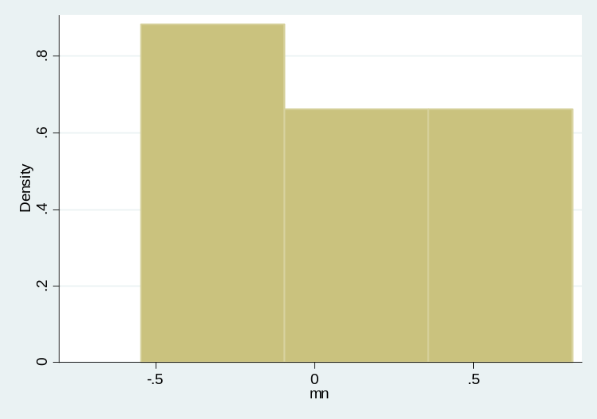
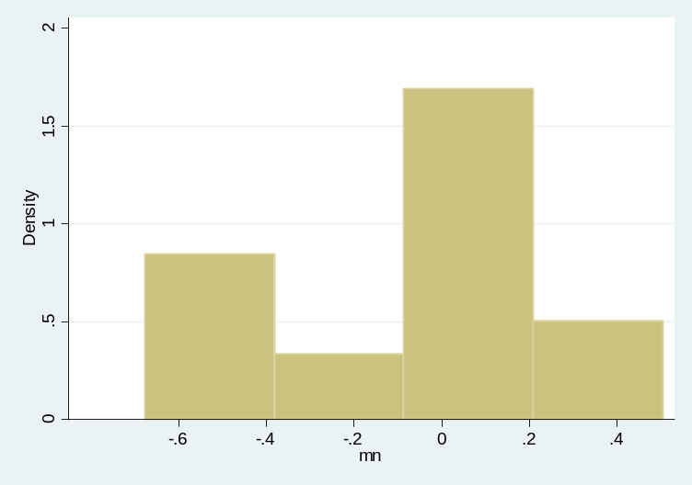
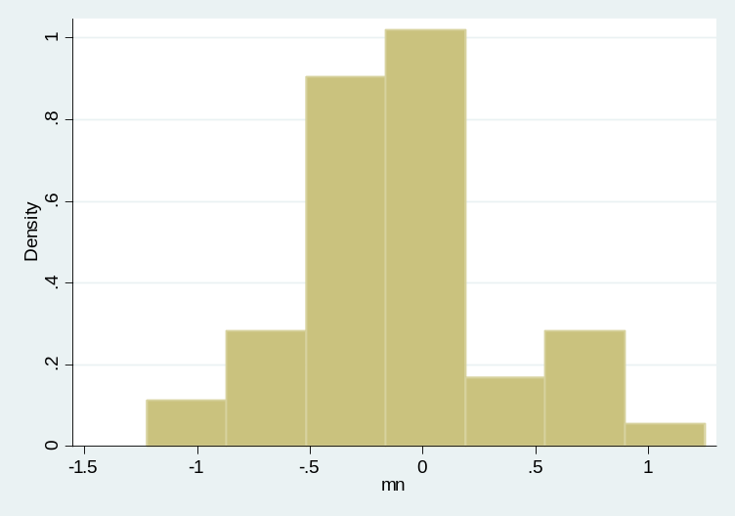
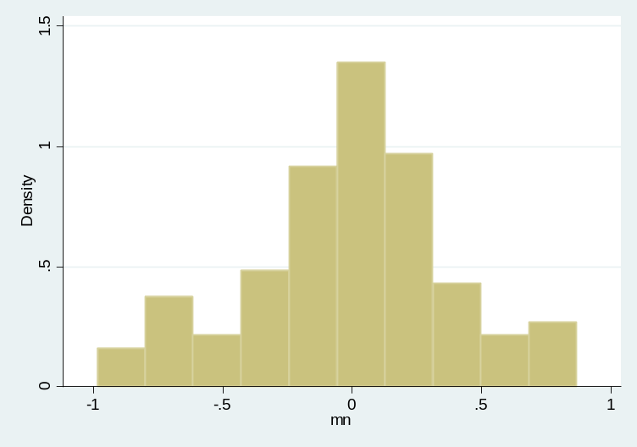
As the number of samples increases, the distribution of sample means approaches
a normal distribution with a mean equal to the population mean
10 Samples
20 Samples
50 Samples
100 Samples
Notes:
Draw a normal distribution on the board. Talk about how it’s possible to draw a really unusual sample, but it’s not likely. Spend time on this.

Slide 10
Standard error of the mean
(different from standard error of the estimate)
A description of the standard deviation of the distribution of sample means.
As we just saw, this is related to the sample size.
  Larger samples mean smaller variation in sample means.

Slide 11
How it comes together
Recalling the reading program example, we want to know whether the post-treatment sample of scores “looks like” the original sample.
We know, by the CLT, sample means are normally distributed.
We know how to calculate the standard error of those sample means.
This allows for the conversion of our sample mean to a z-score that can be compared to the standard normal distribution.

Slide 12
Reading program example, continued
Pre-treatment scores have a mean of 45 and a standard deviation of 10
Post-treatment score mean = 49
H₀: post treatment scores = 45 (no change)
H₁: post treatment scores ≠ 45

Slide 13
Reading program example, continued
Pre-treatment mean
(our null hypothesis)
Post-treatment mean
Population standard
deviation
Standard error of mean
Sample size

Slide 14
Reading program example, continued
Pre-treatment mean
(our null hypothesis)
Post-treatment mean
Population standard
deviation
Standard error of mean
Sample size
Note: We assume here that our pre-treatment
sample mean and sd are the same as the population parameters.
This isn’t quite right, but we discuss how to deal with this next week.

Slide 15
Reject the null
z = 2.4
Checking pg. 467 in our book we see that a average score of 49 is greater than 99.18% of the means we would expect to see if the sample had not changed
Conversely, there is a 0.82 % chance we would see a score of 49 or higher if scores had not changed
Further, we know 1.64% of sample means will have z-scores as or more extreme (on either side of the mean)
This exceeds the typical α=.05 threshold for rejecting the null hypothesis
Thus we reject our null hypothesis with the recognition that there is a 1.64% chance we made a type I error (rejected the null when in fact it was true)

Slide 16
Hypothesis testing vocabulary, part 2
We never “accept” the null, we just “reject the null” or “fail to reject the null”.
  If the null hypothesis is rejected, we conclude that the alternative hypothesis is true within the scope of our alpha.
  If the null hypothesis is not rejected, we conclude that the data do not provide sufficient evidence to support the alternative hypothesis (i.e. we don’t know at this time).

Slide 17
Mid-quarter section evaluation
Please fill out an evaluation to let me know how to improve this class for you!

